Slide 1
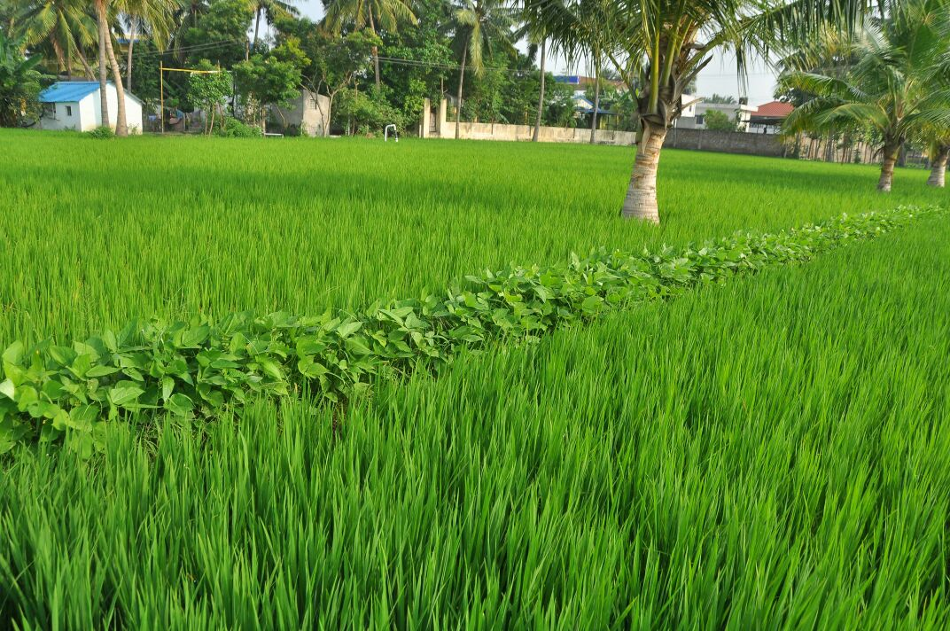
DEPARTMENT OF AGRICULTURE GOVERNMENT OF ANDHRA PRADESH
IMPLEMENTATION OF
PRADHAN MANTRI FASAL BIMA YOJANA (pmfby)

Slide 2
Coverage scenario :: Kurnool Dist :: Kharif 18
Crops notified | Scheme | DES | e- Panta | Satellite | Area covered under Insurance | % coverage with DES
Rice (VIU) | PMFBY (Oriental Insurance Company) | 88858 | 90242 | 145044 | 22512 | 25.30%
Bajra |  | 6612 | 4767 | NA | 17 | 0.30%
Redgram |  | 67342 | 73734 | 68118 | 1544 | 2.30%
Sunflower |  | 723 | 415 | NA | 32 | 4.40%
Jowar |  | 742 | 4062 | NA | 336 | 45.30%
Chilly (I & UI) |  | 16238 | 14289 | 15031 | 2278 | 14.00%
Cotton (I & UI) |  | 259498 | 290715 | 260323 | 42560 | 16.40%
Castor |  | 19610 | 11304 | NA | 500 | 2.60%
Sugarcane (P) |  | 440 | 543 | NA | 25 | 5.80%
Sugarcane ® |  | 255 | 245 | NA | 5 | 1.80%
Korra |  | 3215 | 1530 | NA | 36 | 1.10%
Maize |  | 40845 | 43074 | 41773 | 5583 | 13.70%
Onion |  | 18900 | 12237 | 9128 | 736 | 3.90%
Groundnut | RWBCIS (SBI-Gen) | 89187 | 97690 | 94714 | 92901 | 104.20%
Tomato |  | 2191 | 1677 | NA | 45 | 2.10%
Total for Kharif 2018 |  | 614656 | 646524 | 634131 | 169110 | 27.51%

Slide 3
Achievements during 2018-19
Encouraging enrollment of Non loanee farmers through CSCs
Conducting Publicity & Awareness cum Spot enrollment Campaign for improving penetration
Successful coverage of Risks at all stages Ex:Prevented Sowings : G.Nut-Kadapa:Kh 18
Mid season adversity : Srikakulam Paddy Kh 18
Post harvest losses : Mainly in Krishna Dist Phethai Cyclone
Close Monitoring of Technical issues especially during enrollment period and while data entry in to the PMFBY portal in coordination with GOI.
1
2
4

Slide 4
DISTRICT WISE IMPLEMENTATION OF PMFBY AT A GLANCE :: KHARIF 2016 TO RABI 18-19
District | No of farmers enrolled |  |  | Area insured in Lakh Ha | Sum Insured (Rs in Crores) | Amount Rs in Crores
 | Loanee | Non loanee | Total |  |  | Farmer share | State share payable | GOI Share | Claims paid (Kharif 16 to Rabi 17-18)
Anantapur | 1643041 | 201231 | 1844272 | 26.8 | 11089.0 | 224.2 | 583.9 | 583.9 | 1220.7
YSR Kadapa | 467819 | 412668 | 880487 | 9.7 | 5059.1 | 122.9 | 320.6 | 320.6 | 602.3
Kurnool | 346920 | 334260 | 681180 | 8.3 | 4297.2 | 103.6 | 139.6 | 139.6 | 97.5
Prakasam | 67292 | 244940 | 312232 | 2.7 | 1665.1 | 41.7 | 50.5 | 50.5 | 62.9
Chittor | 141421 | 75105 | 216526 | 1.7 | 1270.7 | 38.0 | 23.5 | 23.5 | 41.6
Srikakulam | 519669 | 27108 | 546777 | 3.8 | 2659.8 | 53.4 | 82.0 | 82.0 | 29.8
Guntur | 123990 | 13757 | 137747 | 1.1 | 1037.2 | 35.9 | 19.6 | 19.6 | 29.6
East Godavari | 479954 | 17471 | 497425 | 3.2 | 2391.4 | 49.0 | 120.5 | 120.5 | 14.3
SPS Nellore | 86530 | 16824 | 103354 | 1.3 | 823.9 | 14.6 | 8.8 | 8.8 | 13.5
Krishna | 259260 | 20719 | 279979 | 2.2 | 1894.2 | 45.7 | 40.0 | 40.0 | 6.9
Vizianagaram | 198509 | 40758 | 239267 | 1.6 | 1123.0 | 23.4 | 27.4 | 27.4 | 5.4
West Godavari | 439635 | 53907 | 493542 | 3.2 | 2258.6 | 45.9 | 58.2 | 58.2 | 5.0
Visakha-patnam | 102784 | 23613 | 126397 | 0.8 | 678.6 | 17.9 | 15.0 | 15.0 | 2.1
Grand Total | 4876824 | 1482361 | 6359185 | 66.3 | 36247.8 | 816.3 | 1489.5 | 1489.5 | 2131.6
Claims for Kharif 2018 and Rabi 2018-19 are yet to be paid.

Slide 5
KEY CHALLENGES AHEAD
Performance of AEO/MPEO will be evaluated on the basis of area covered (vs) area insured in his jurisdiction.
Hence the field level officers should closely monitor progress in coverage of Notified crops.
To achieve Crop Insurance enrolment Target i.e., at least 50% coverage , out of Gross Cropped area.
Primary workers to ensure prompt submission of required CC Experiment forms (Form-I, II, III) within the stipulated time. This causes delay in calculation of Actual Yield data thereby settlement of claims.
100% uploading of Crop Cutting Experiments data through CCE App
1
2

Slide 6
KEY CHALLENGES AHEAD
There is every need to educate Non loanee farmers for improving quality of required documents to be uploaded through CSCs, to avoid rejection of proposal by ICs at Later stage.
To educate farmers that no extra amount needs to be paid at CSCs apart from Premium receipt generated.
To create awareness among the farmers about the impact on claim settlement in the event of excess area insured against the Actual area sown. In this situation, companies will apply Area Correction Factor to reduce the claim which causes great loss to the genuine farmer.
3
4

Slide 7
Action Plan for Kharif,2019
Scheme | Crops | Insurance Unit | Indemnity level (%) | Sum Insured/SOF 2019-20 (Rs/Ha) | % of Farmers Premium
PMFBY | Rice | VIU | 80% | 82,500 | 2%
 | Jowar | DIU | 80% | 25,000 | 2%
 | Bajra | MIU | 80% | 25,000 | 2%
 | Redgram | MIU | 80% | 40,000 | 2%
 | Sunflower | MIU | 80% | 35,000 | 2%
 | Chilly (I) | DIU | 80% | 2,00,000 | 5%
 | Chilly(UI) | DIU | 80% | 2,00,000 | 5%
 | Cotton (I) | DIU | 80% | 1,25,000 | 5%
 | Castor | DIU | 80% | 32,500 | 2%
 | Sugarcane (P) | DIU | 90% | 1,62,500 | 5%
 | Sugarcane ® | DIU | 90% | 1,37,500 | 5%
 | Korra | MIU | 80% | 22,500 | 2%
 | Onion | DIU | 80% | 75,000 | 5%
 | Maize (MIU) | MIU | 80% | 75,000 | 2%
RWBCIS | Groundnut | MIU | Weather based | 50,000 | 2%
 | Tomato | MIU |  | 75,000 | 5%
 | Cotton (UI) | MIU |  | 90,000 | 5%
Enrollment period starts from 01-04-2019 for all crops. For Rice Crop, cutoff date ends with 21-08-19 and for other crops 31-07-2019 under PMFBY.
For Groundnut, Cotton UI Crops cutoff date ends with 15-07-2019 and for Tomato 09-08-2019 under RWBCIS.

Slide 8
STATUS OF NOTIFICATION FOR 2019-20
Floating of Financial Bid -- 25th March
Bids will be opened on 18th April 2019 for Kharif 2019 and Rabi 2019-20 seasons.
During 2019-20, State has been divided into 4 uniform clusters under PMFBY and 2 clusters under RWBCIS.
1
Scheme | Cluster No | Districts covered
PMFBY | I | West Godavari, Prakasam, Kurnool
 | II | Visakhapatnam, SPS Nellore, YSR Kadapa
 | III | Vijayanagaram, East Godavari, Guntur, Anantapuram
 | IV | Srikakulam, Krishna, Chittor
RWBCIS | I | Anantapuram
 | II | Remaining 12 Districts and all crops
4

Slide 9
THANK YOU

