Slide 1
JDA (Soil Correlator)

Slide 2
Soil Health Card Scheme
Soil sample collection:
Collection of representative soil sample
Record correct Latitude and longitude (Geo coordinates) while collection of representative Soil sample from the field.
Involvement of the farmers in soil sample collection.
Submission of 500gms of processed soil samples (pounded & sieved) to the STLs.
Uploading in NIC portal:
Main farmer details along with grid farmers
Proper entry of sample unique ID (8 digit number)
Submission of soil samples along with lists duly uploading farmers data
Correct Crop selection in SHC portal
SMS alert to farmers:
Collect mobile number of the farmers to get SMS alerts
Print of Soil Health Card:
Use mee seva facility to get Soil Health Card

Slide 3
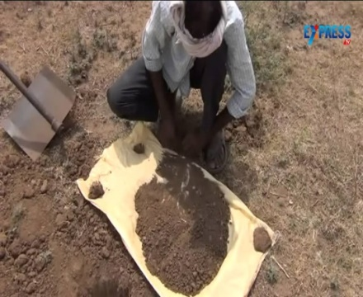
Procedure for Soil sample collection
+ + + + + + +
Collect soil sample in a random zig zag manner from 10 to 15 spots.
Dig a “V” shaped pit up to 15 cm depth and take thin uniform slice of soil from the spots.
The soil collected is thoroughly mixed and the bulk is reduced by quartering and finally about 500 gms of composite sample is retained.
The sample must be air dried in shade and put in a cloth or polythene bag with information sheet
Send the processed (pounded and sieved) soil samples to the STLs for analysis to save the time for analysis at STLs.

Slide 4
Fertility Index in Ananthapur district
S.No | Parameter | Status
I | pH | %
 | Acidic | 0
 | Neutral | 41
 | Slightly Alkaline | 31
 | Moderately Alkaline | 27
 | Highly Alkaline | 1
II | EC (mmhos/cm) | %
 | Normal | 100
 | Critical for germination | 0
 | Harmful to crops | 0
 | Injurious to crops | 0
III | Nutrient status | Low | Medium | High
 | Organic Carbon | 93 | 5 | 2
 | Nitrogen | 91 | 5 | 4
 | Phosphorous | 4 | 16 | 80
 | Potassium | 4 | 15 | 81
 | Sulphur | 3 | 0 | 97
IV | Micronutrients (% deficiency)
 | Zinc | 18
 | Iron | 11
 | Copper | 2
 | Manganese | 3
 | Boron | 15

Slide 5
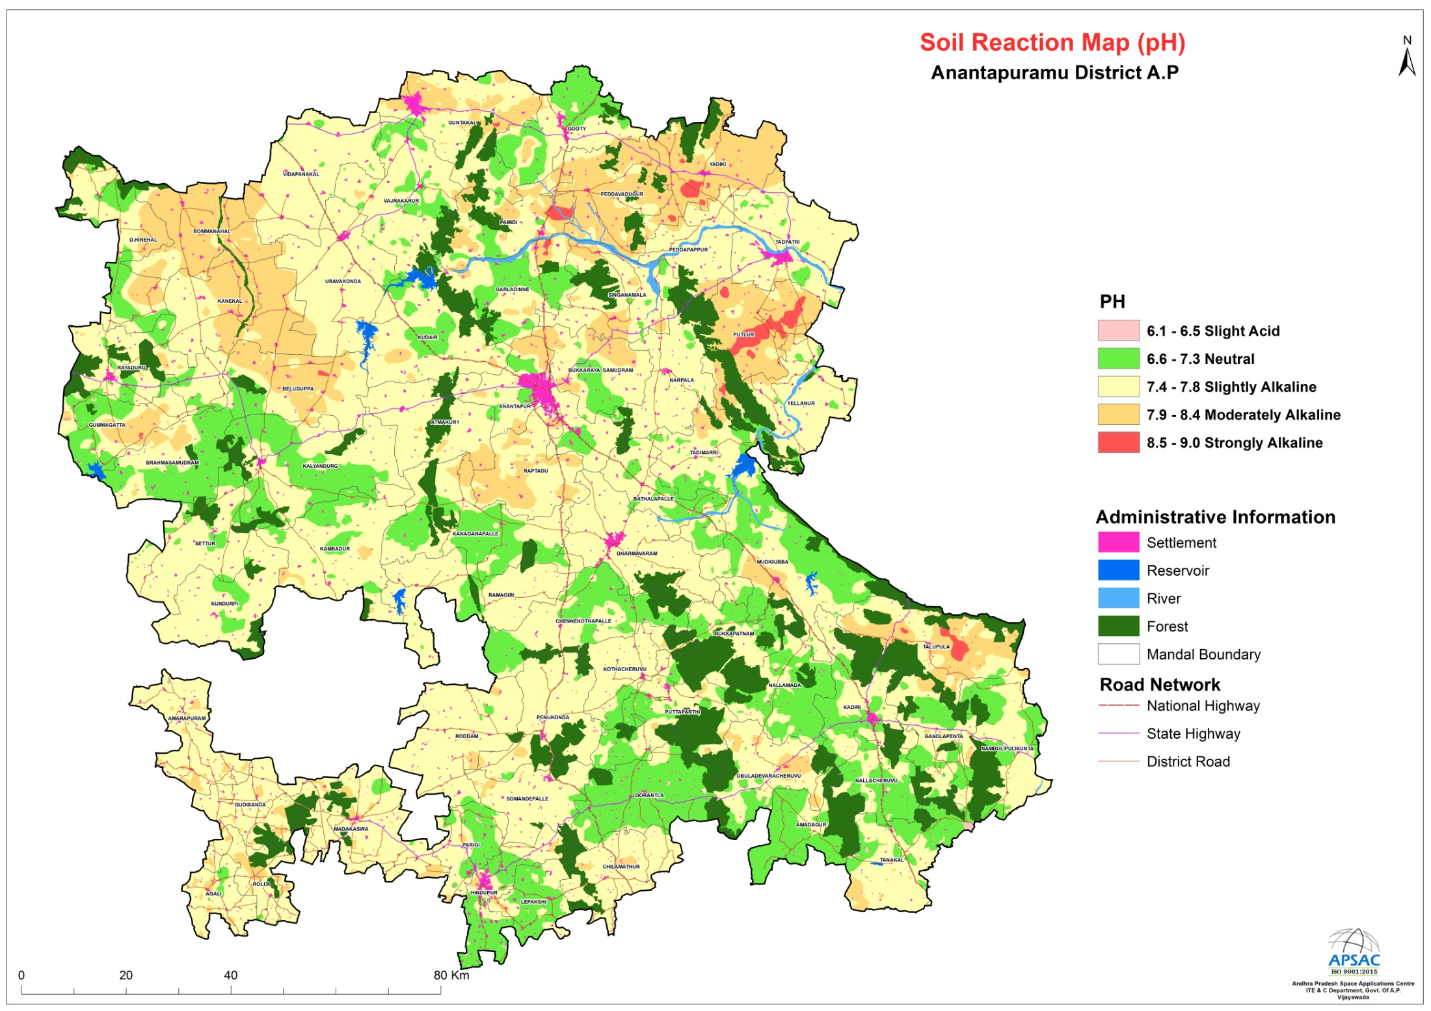

Slide 6
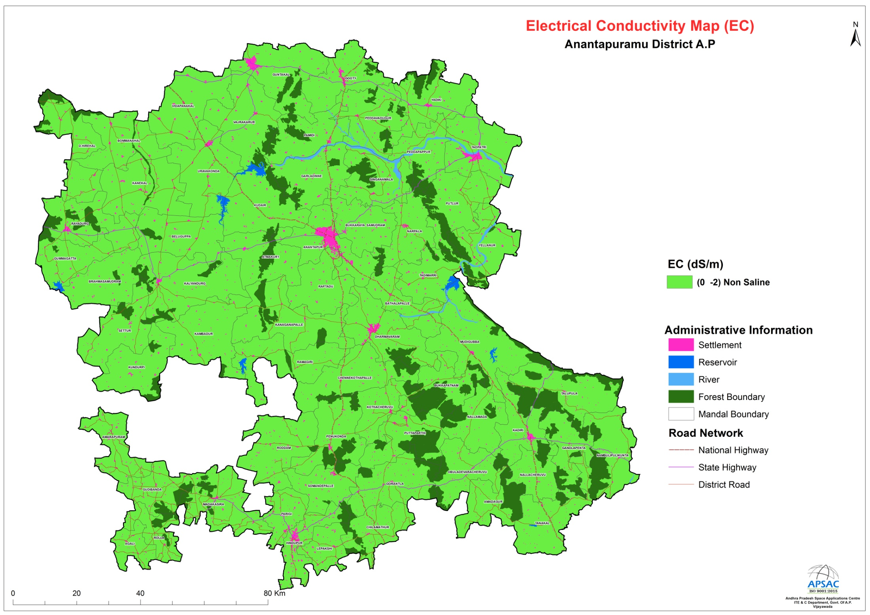

Slide 7
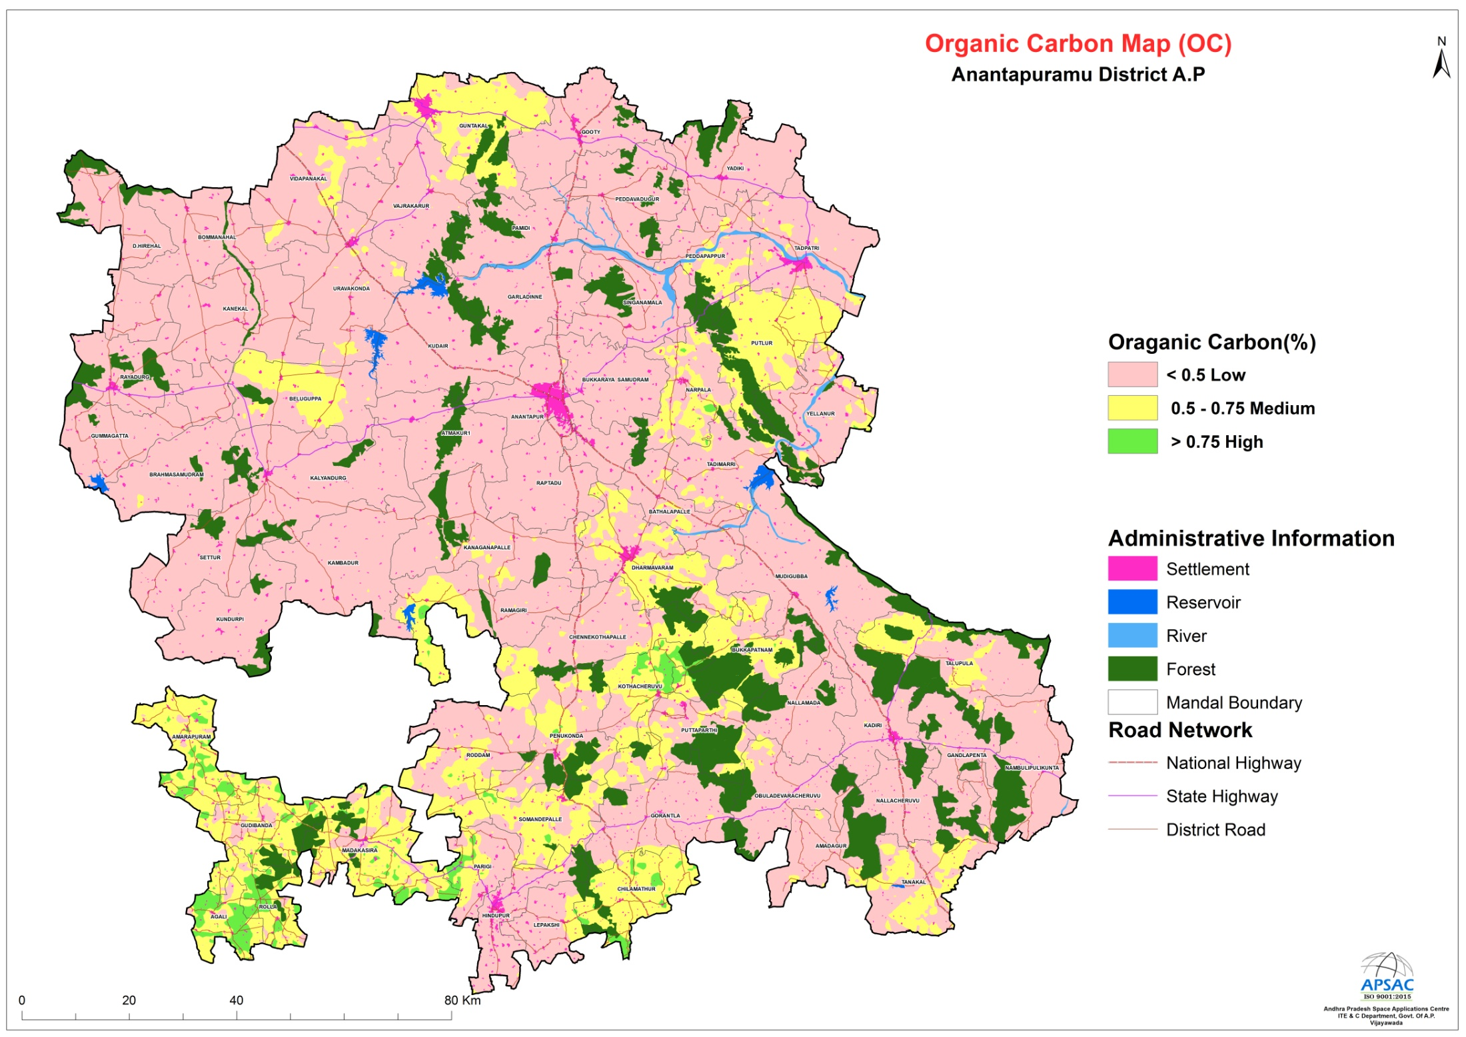

Slide 8
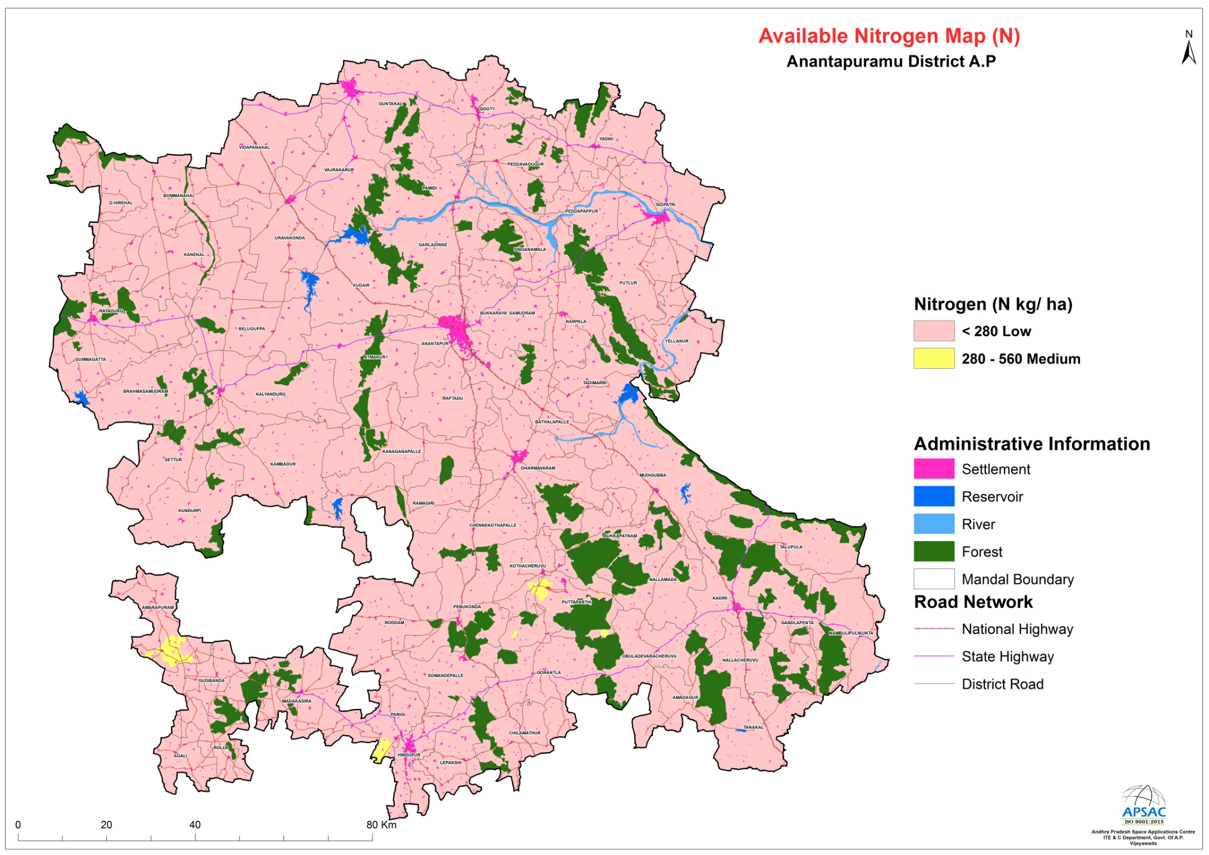

Slide 9
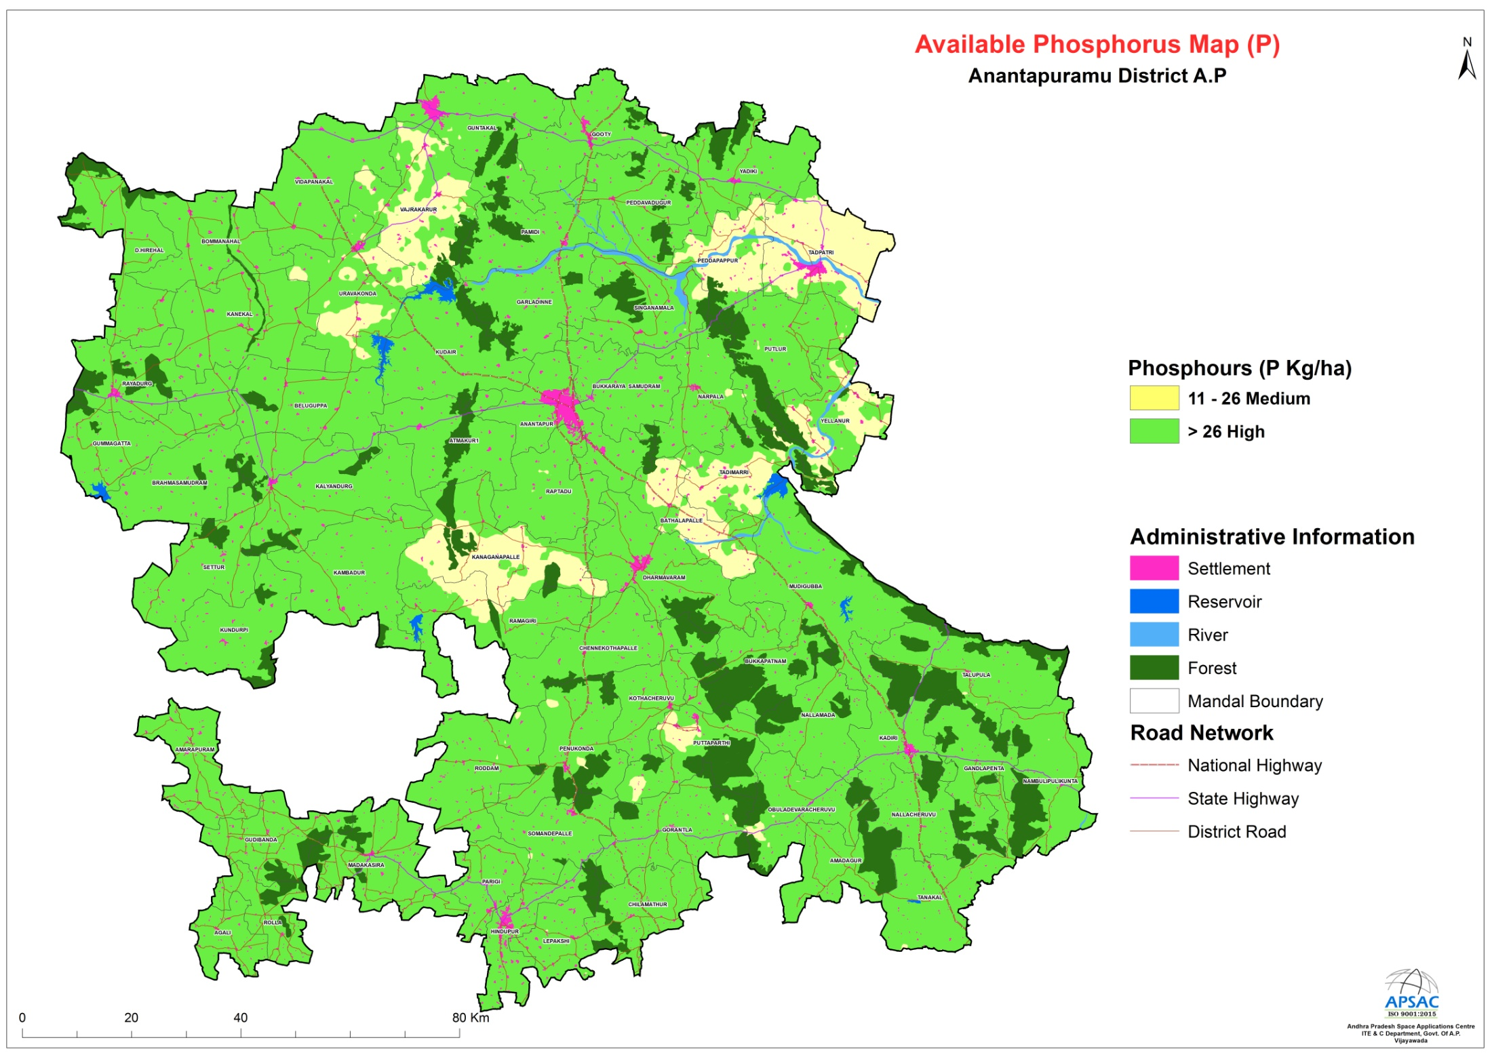

Slide 10
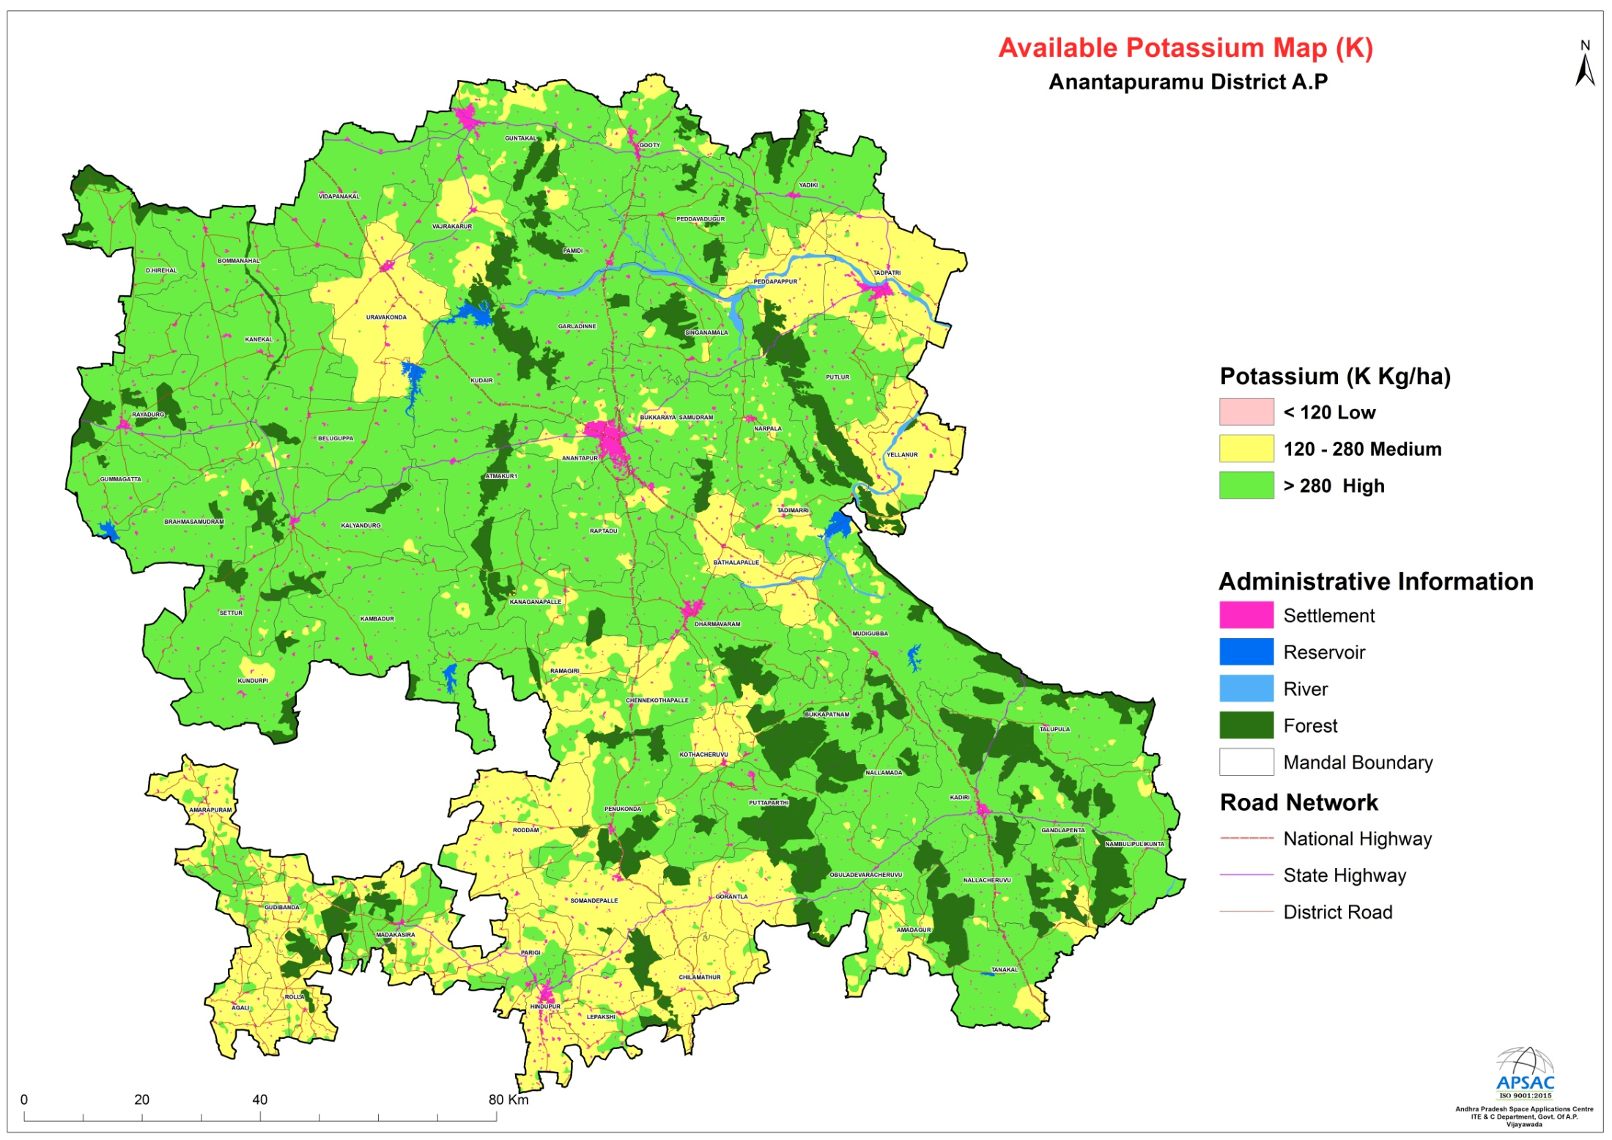

Slide 11
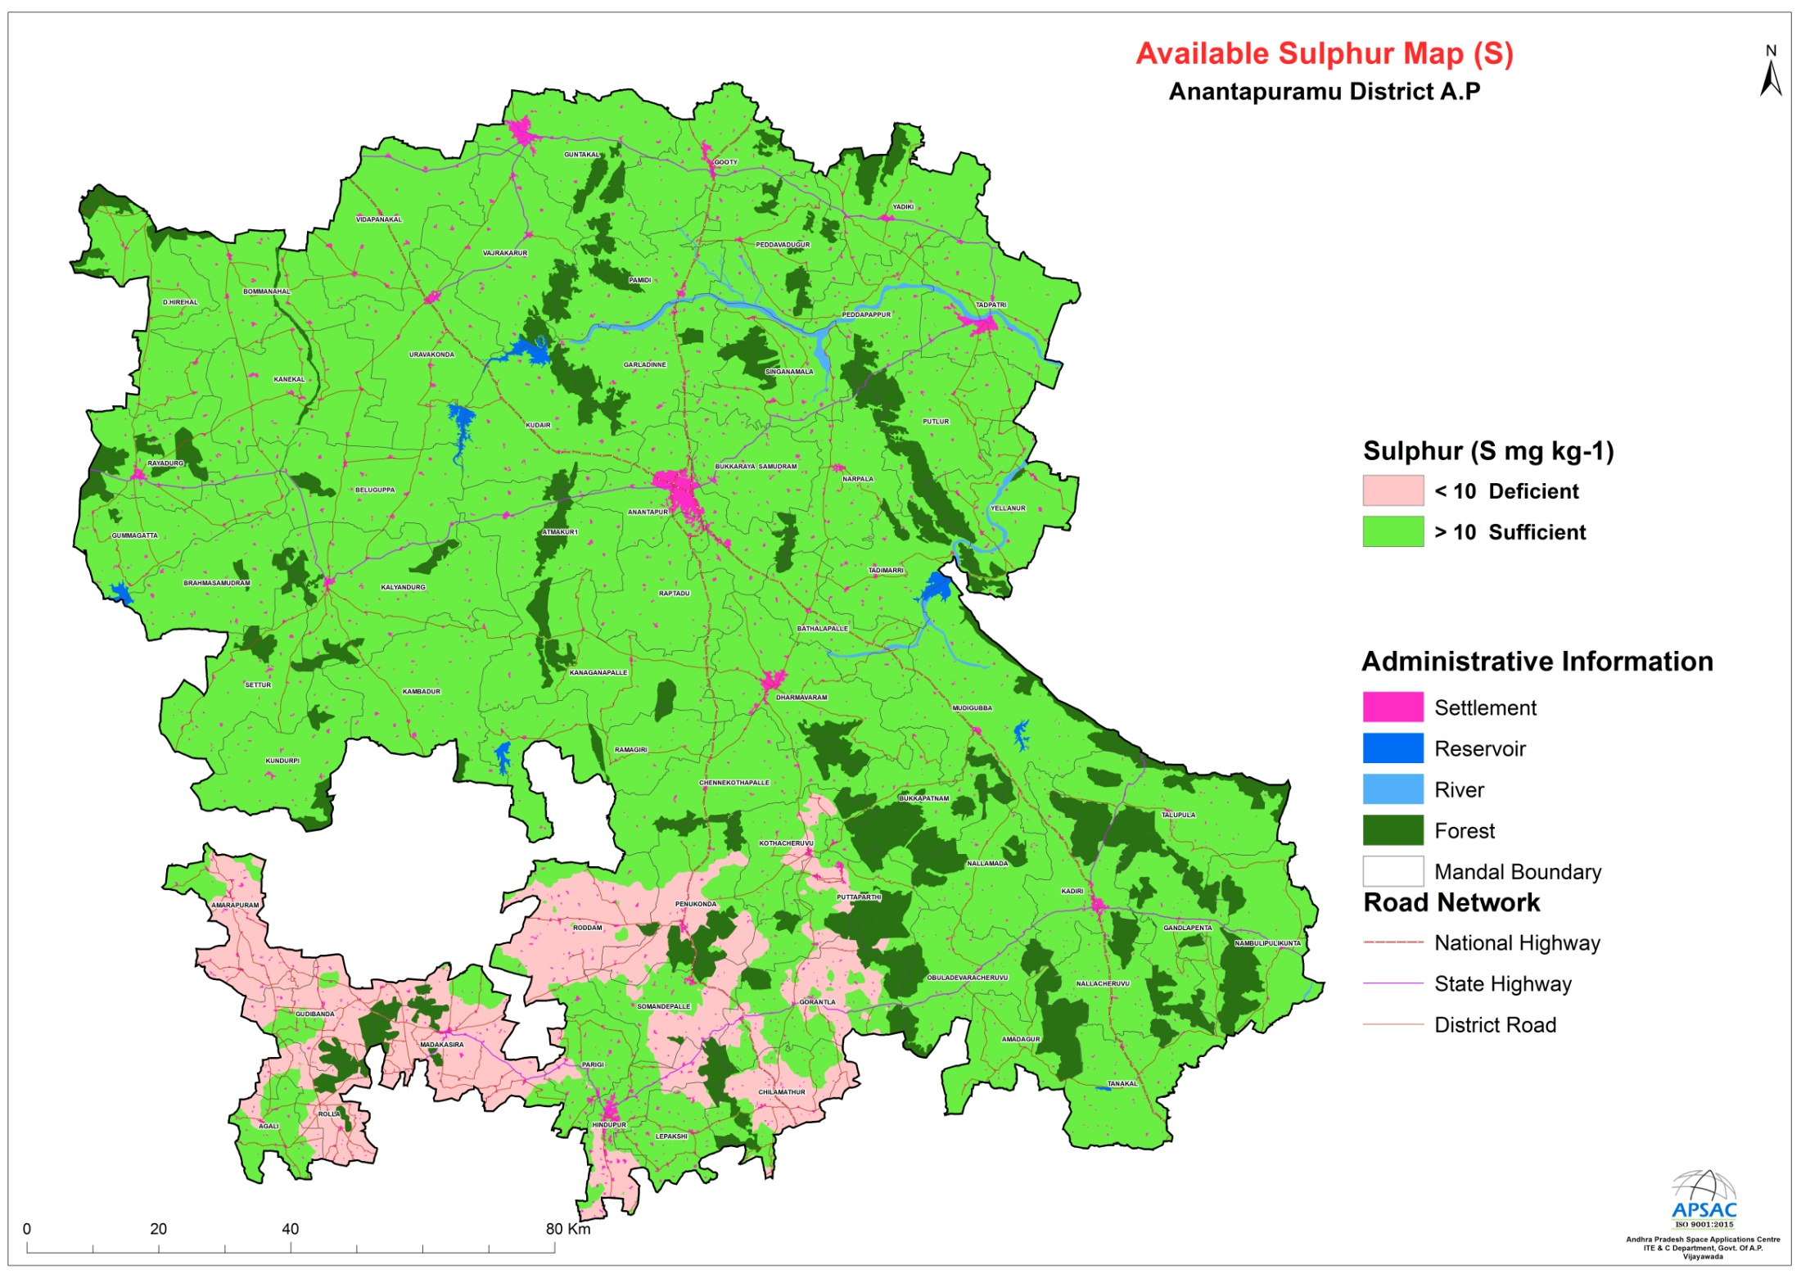

Slide 12
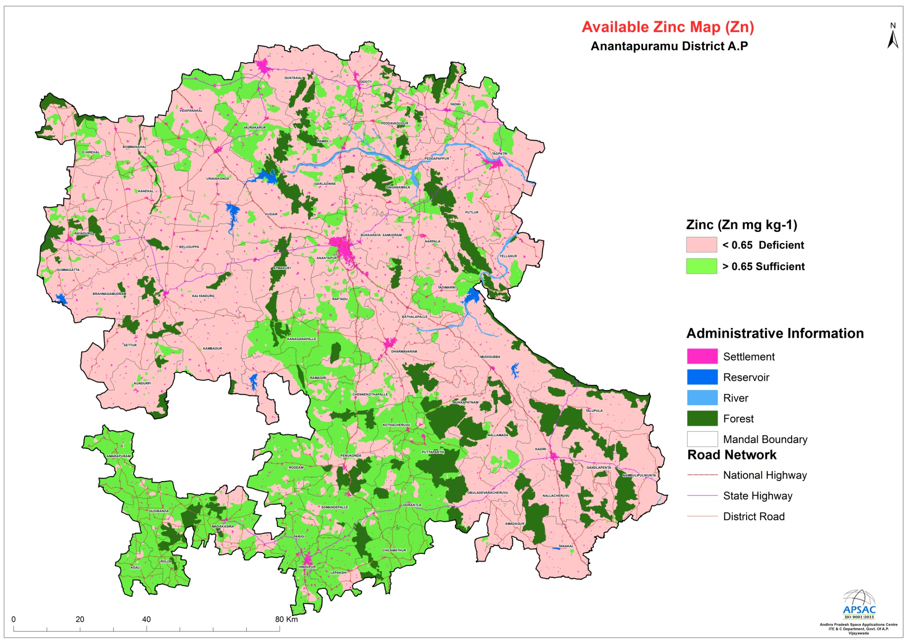

Slide 13
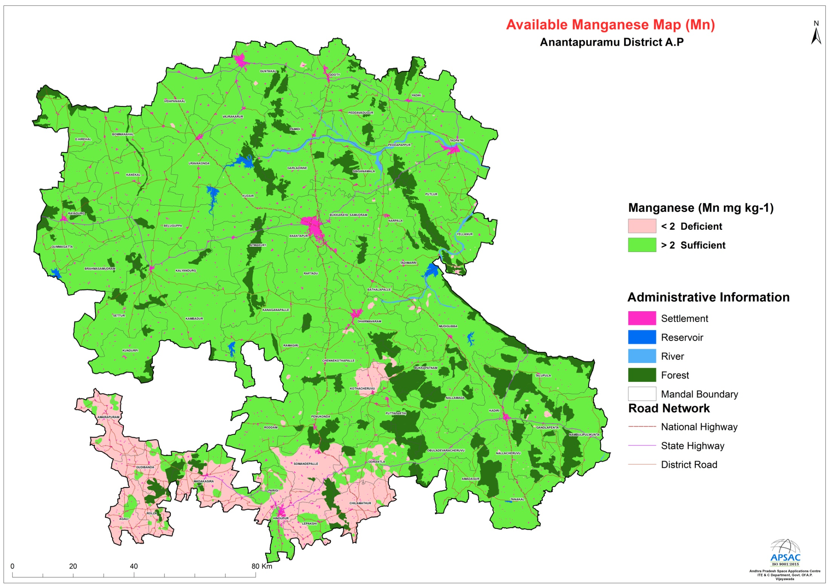

Slide 14
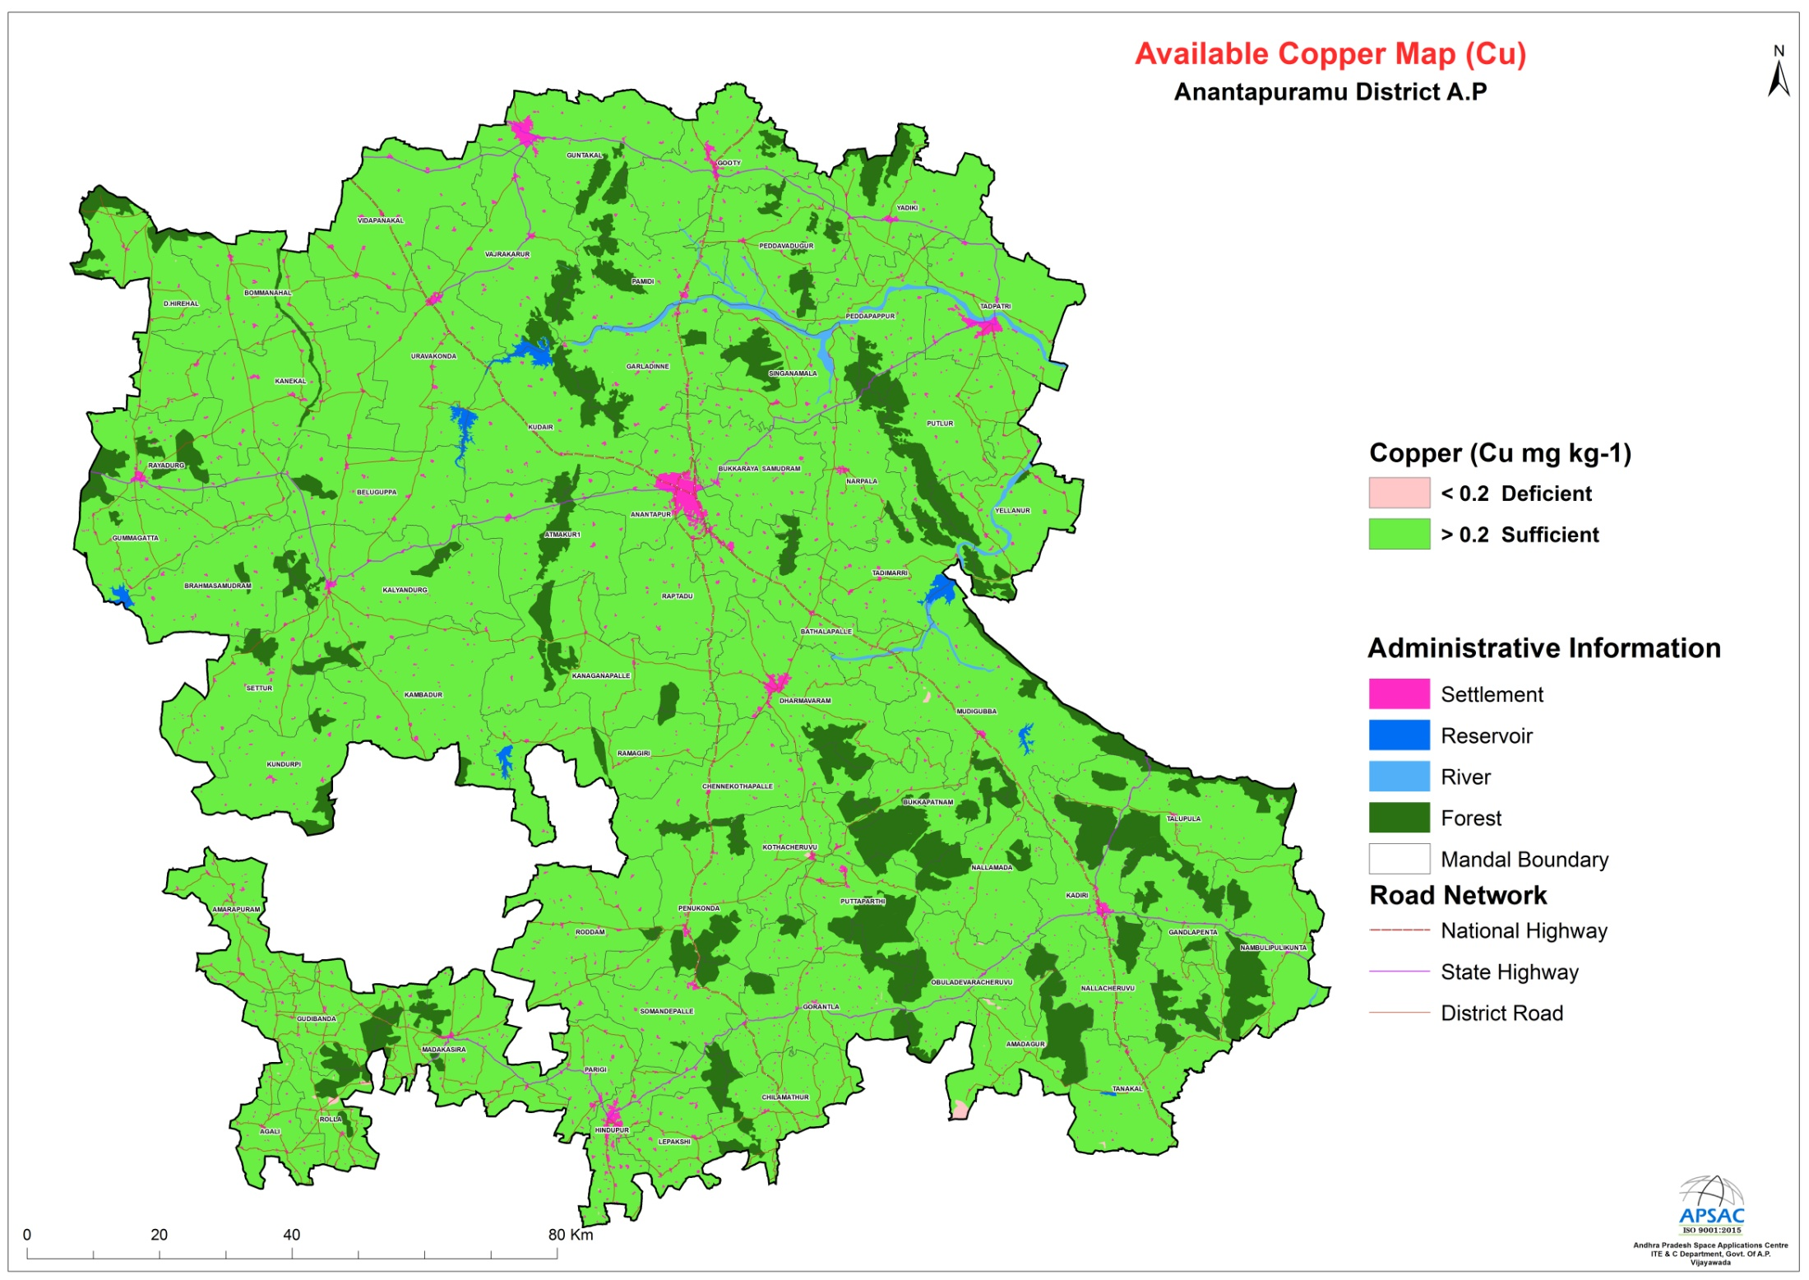

Slide 15
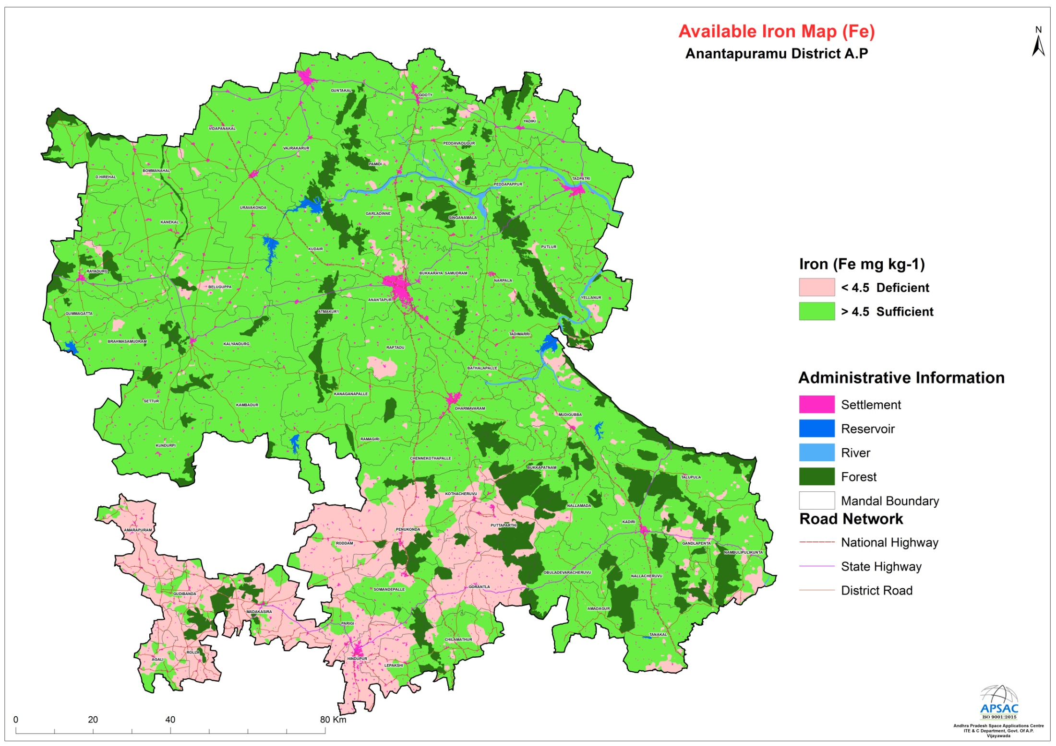

Slide 16
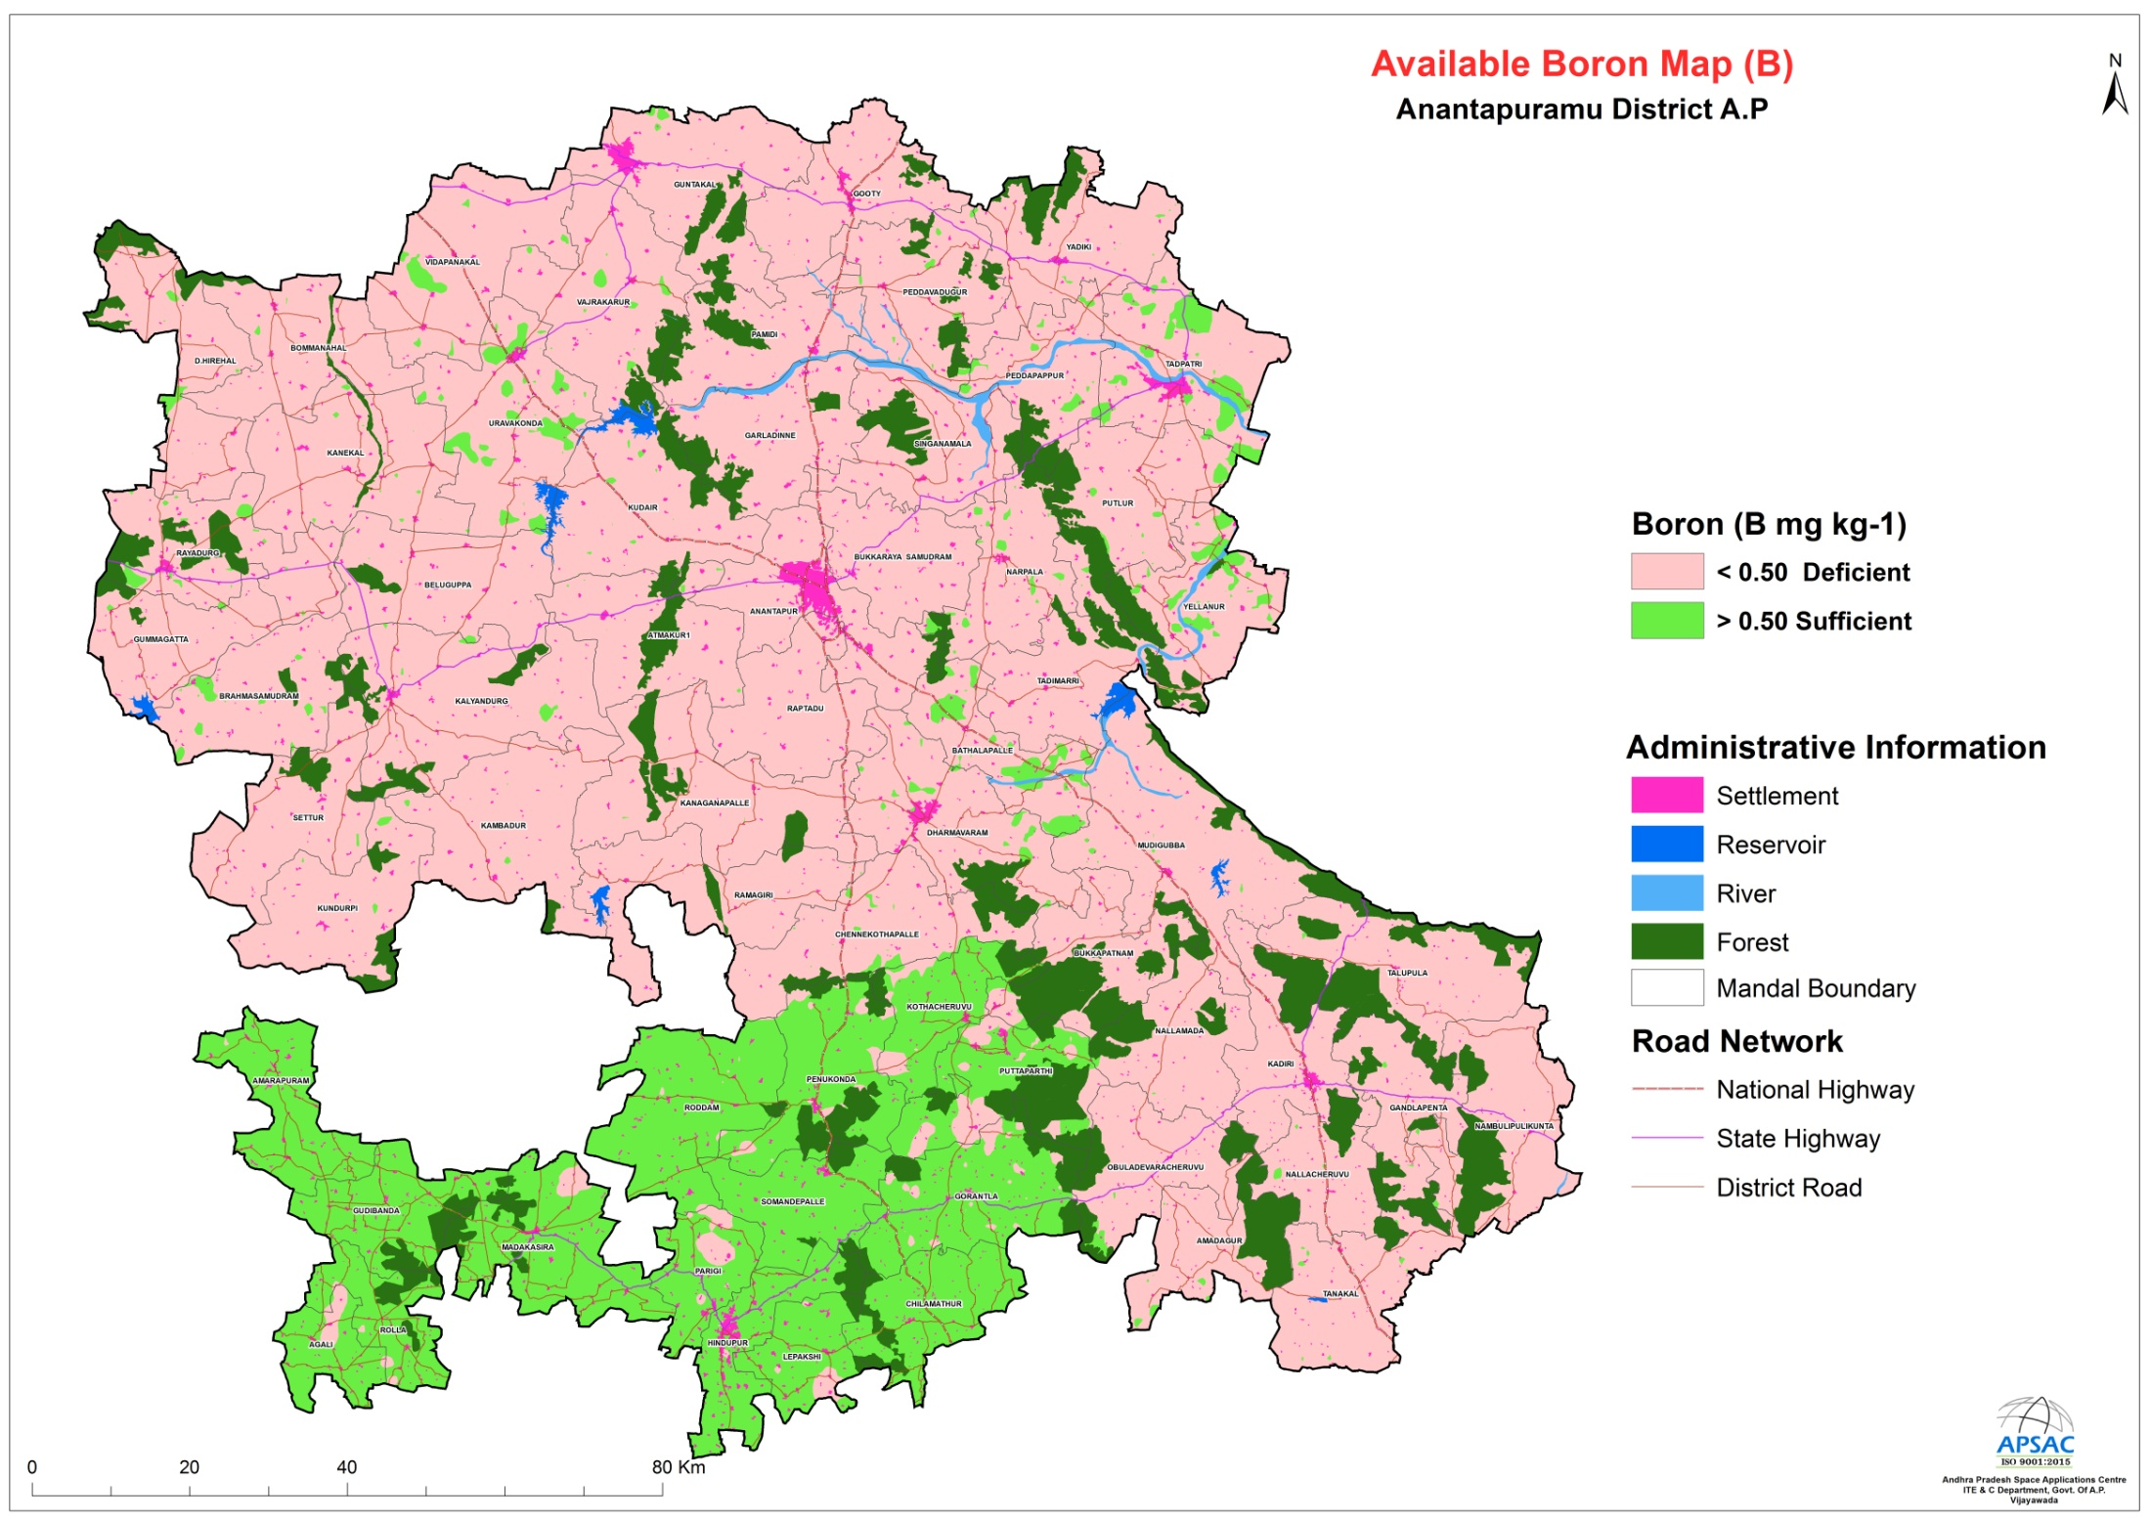

Slide 17
Organic Carbon in Soils
OC tends to concentrated in top soil ranges 0.5-3%, and in desert soils it is <0.5%. In our soils it ranges from 0.01 to 2.81%.
The organic carbon in soils is reduced due to indiscriminate use of chemical fertilizers.
C:N (Carbon: Nitrogen) Ratio 10:1 is ideal in soil.
Importance of soil organic carbon:
Basis of soil fertility
Plays Key role in soil health
Soils with more SOC are more fertile and more productive and easier to manage.
Measures to improve soil organic carbon:
Grow Green manure crops:
Grow Cereal crops:
Spread Manure: Ex: Neem kernal Cakes
Use Organic fertilizers: Ex: Vermi compost, FYM, NADEP
Addition of Crop residues
Crop rotation with pulse crop
Multiple cropping or mixed cropping
Inter cropping of Red gram with Groundnut, Maize and other Millets

Slide 18
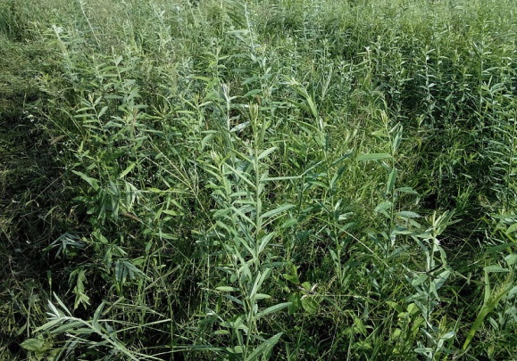
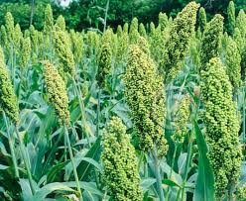
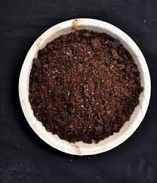
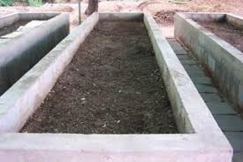
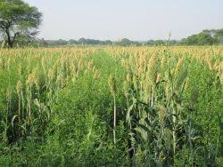
Practices to improve Organic carbon
Grow Green Manure crop-Sun hemp
Grow Cereal crop-Jowar
Spread manure-
Neem cake
Use Organic Fertilizer-Vermi compost
Intercropping-Red gram with Jowar
Multiple cropping

Slide 19
Integrated Nutrient Management Scheme
Micronutrients are being distributed on 100% subsidy based on soil health card through D Krishi app.
The crop cutting experiments shown significant increase in yields of about 8-15%.
Lapses noticed in the implementation
Drawal of Act samples before commencement of distribution.
Online distribution is not being done properly for entire quantities.
CC expts are not done properly and delay in results submission.
Non creation of awareness on foliar application of Zinc.
Creating awareness on identification of deficiency symptoms of micronutrients.

Slide 20
Thank you

